Slide 1
Researching Project Raspberry Pi
Lecturer: Mr. HEL Chanthan
Prepared by Mr. VANNAK Sovannroth
2019-2020

Slide 2
Outline
Download and Installation
Update and Config Static in Raspberry Pi
Test DHT22 with Raspberry pi
Test Send Data from Arduino nano to Raspberry Pi and Connect Port
Test Node 1 with Arduino Uno send Data to Raspberry Pi (Coordinator is the same Node 1)
Setup a Raspberry Pi MYSQL Database
Page 01

Slide 3
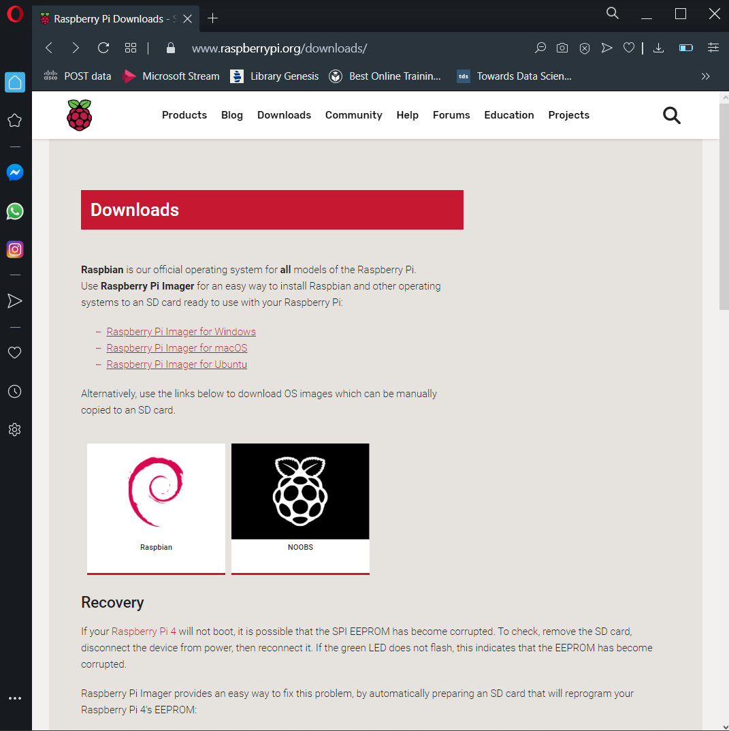
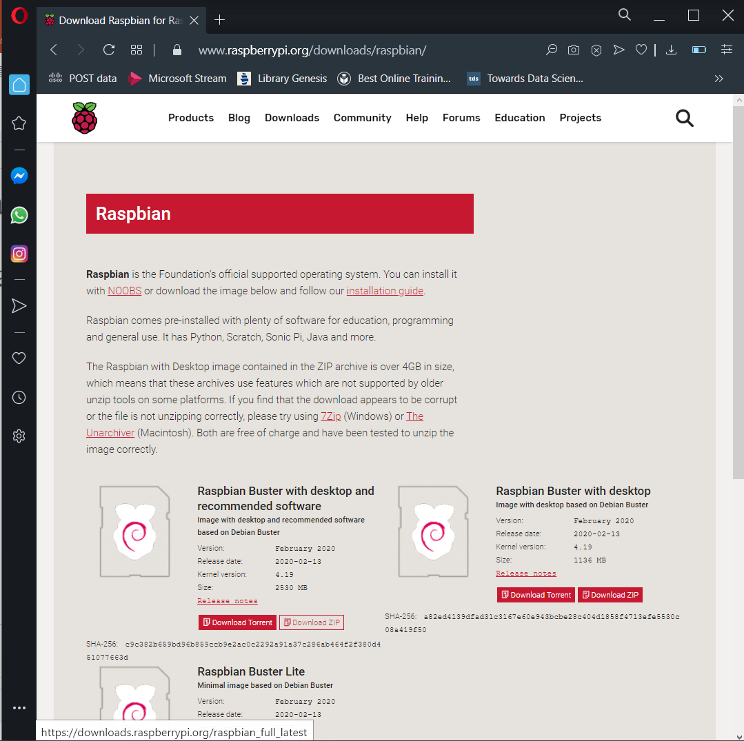
Download and Installation
Download
Page 02

Slide 4
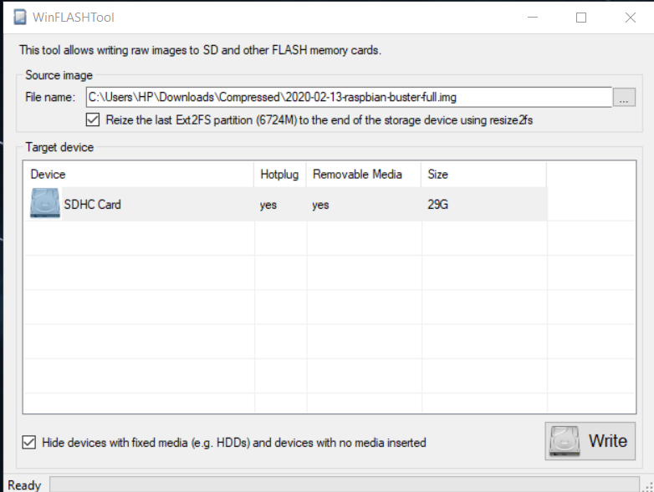
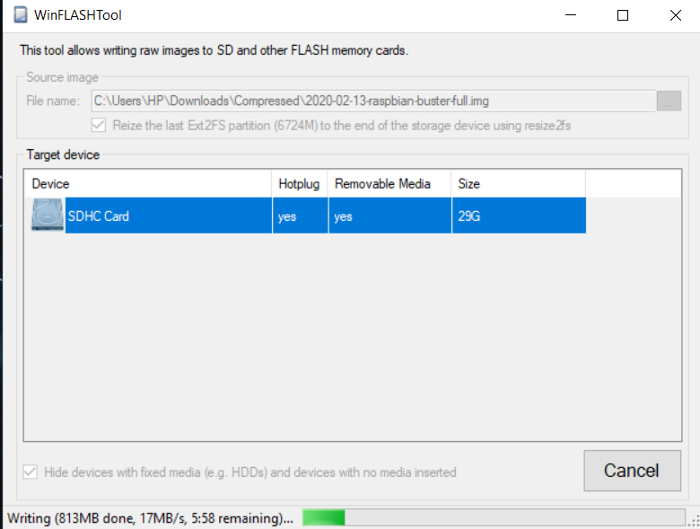
Download and Installation
Installation or Boot
Page 03

Slide 5
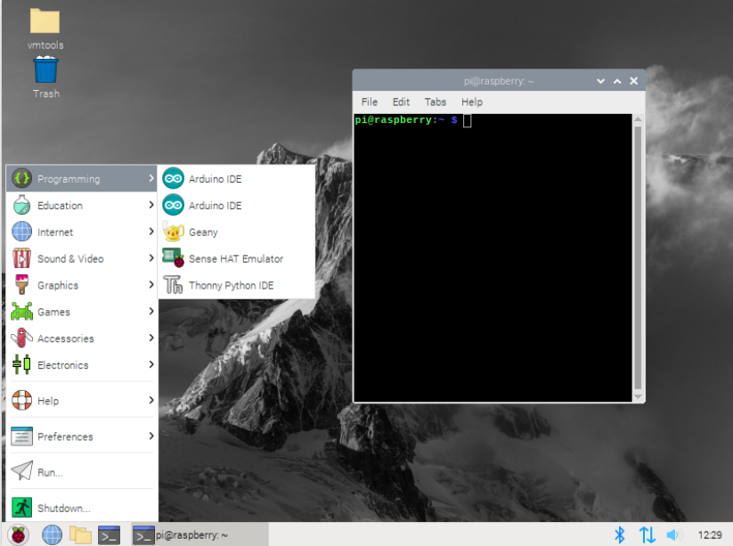
After Installation
Page 04

Slide 6
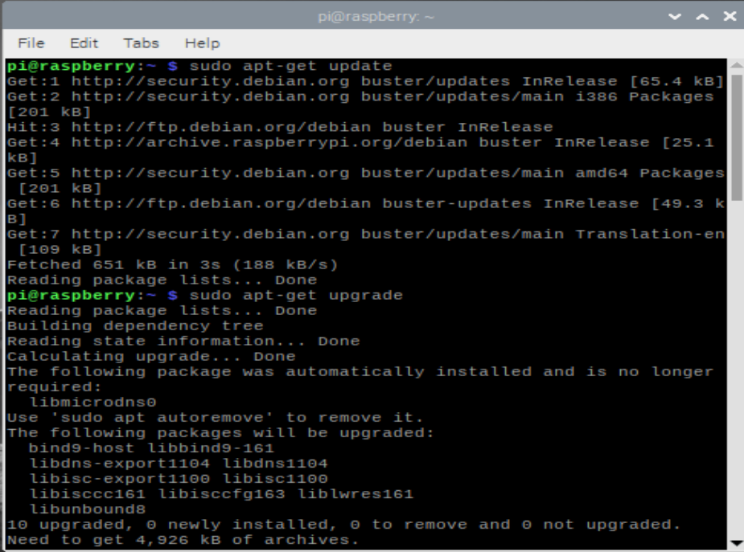
Update and Config Static in Raspberry Pi
Update and Upgrade
Page 05

Slide 7
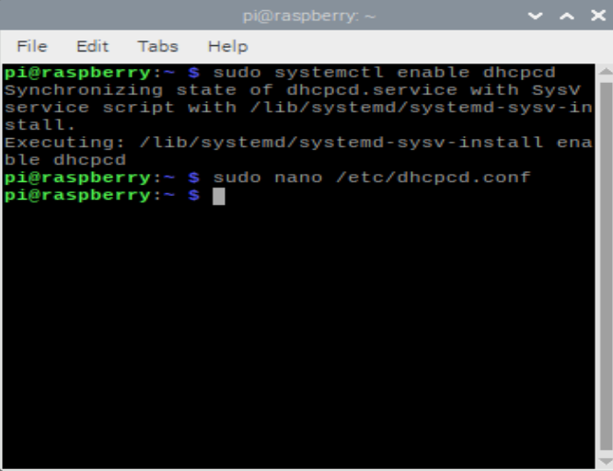
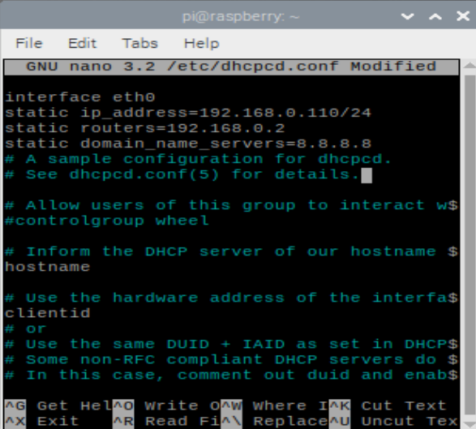
Update and Config Static in Raspberry Pi
Configuration Static
sudo reboot
Page 06

Slide 8
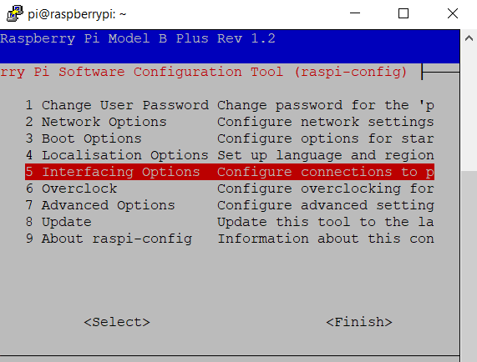
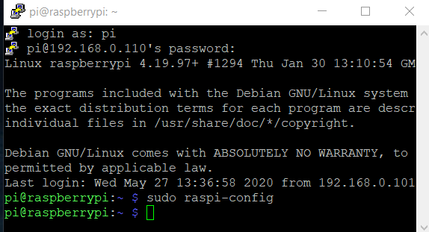
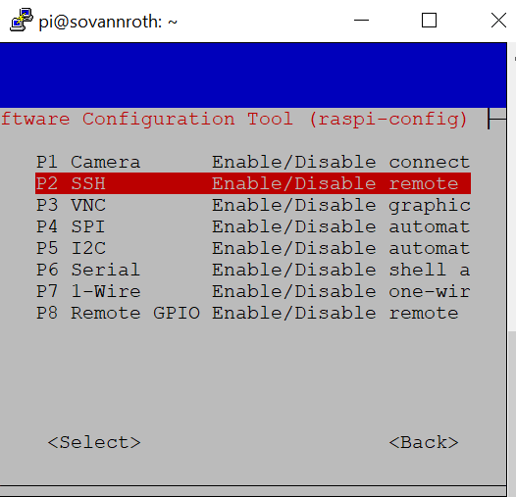
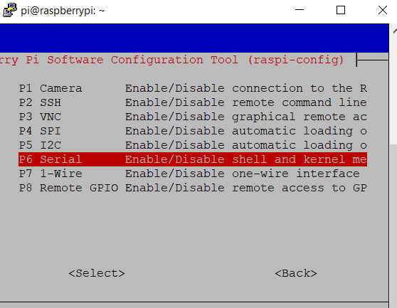
Enable Connection
Page 07

Slide 9
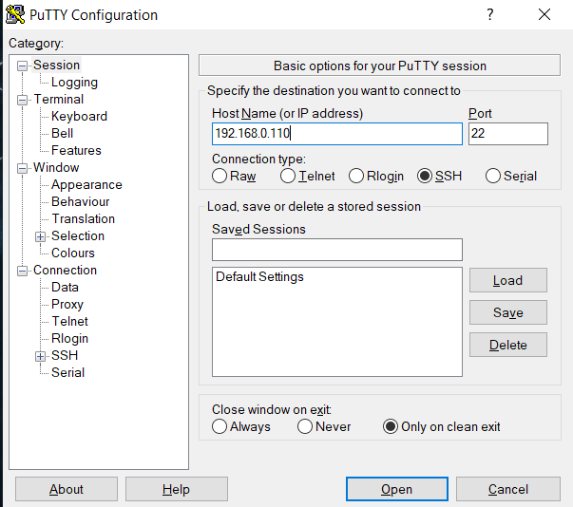
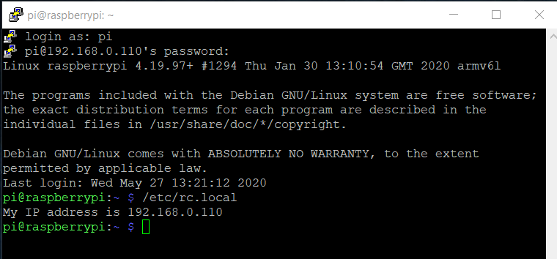
Connect from PC to Raspberry Pi
Page 08

Slide 10
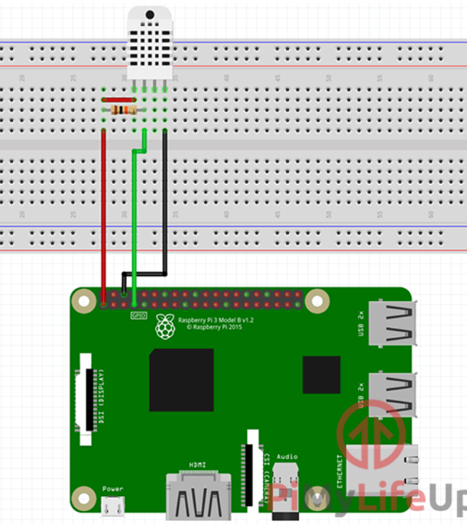
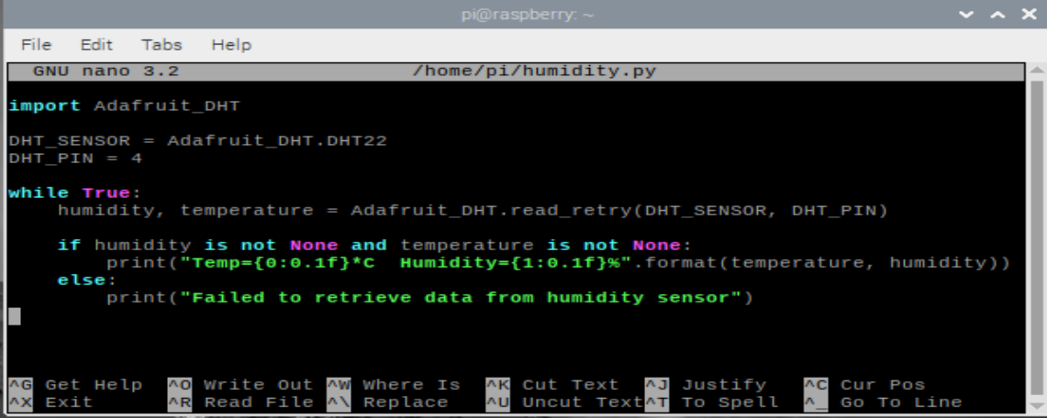
Test DHT22 with Raspberry pi
Command Line
sudo apt-get install python3-dev python3-pip
sudo python3 -m pip install --upgrade pip setuptools wheel
sudo pip3 install Adafruit_DHT
nano ~/humidity.py
python ~/humidity.py
Page 09

Slide 11
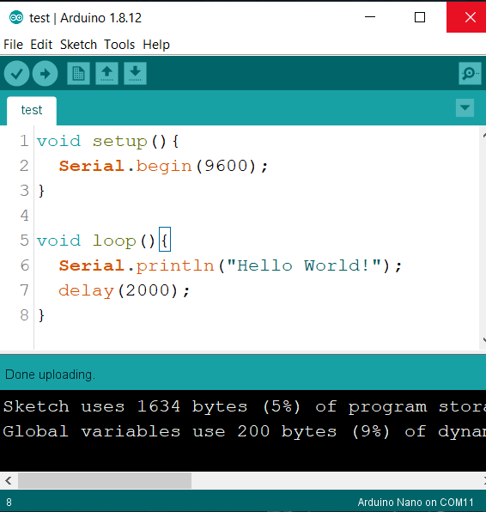
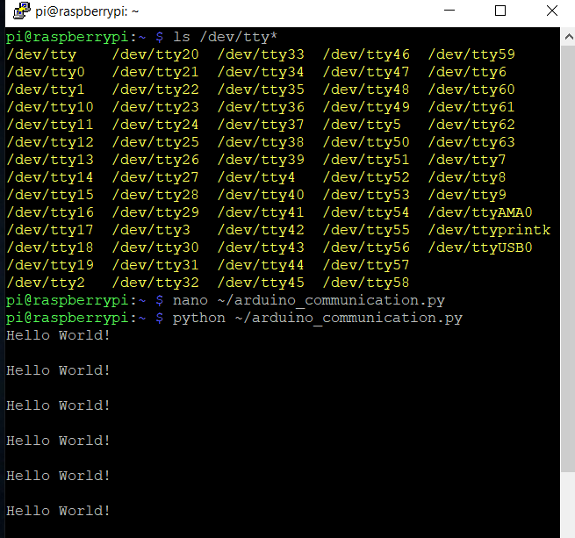
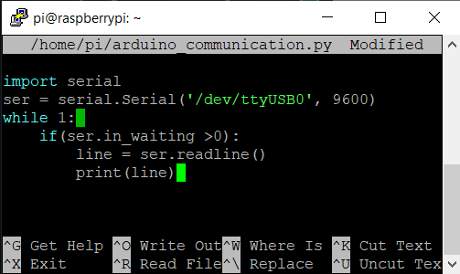
Test Send Data from Arduino nano to Raspberry Pi and Connect Port
Page 10

Slide 12
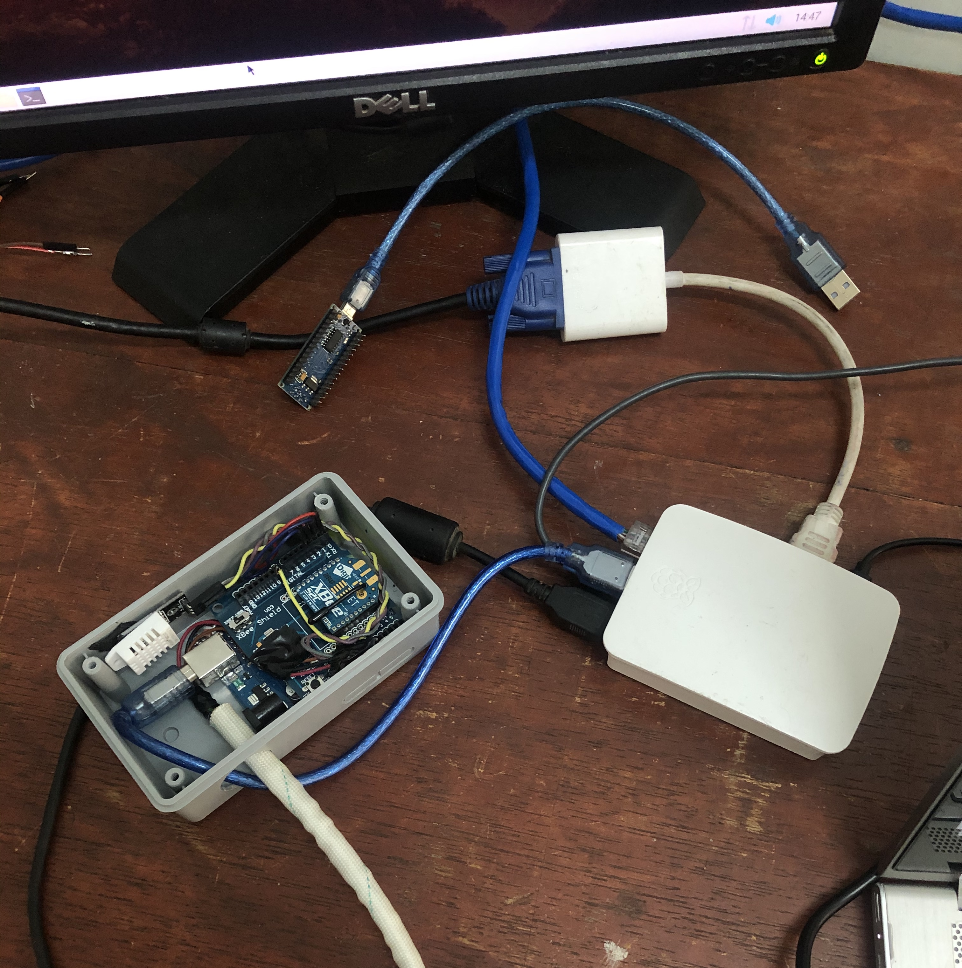
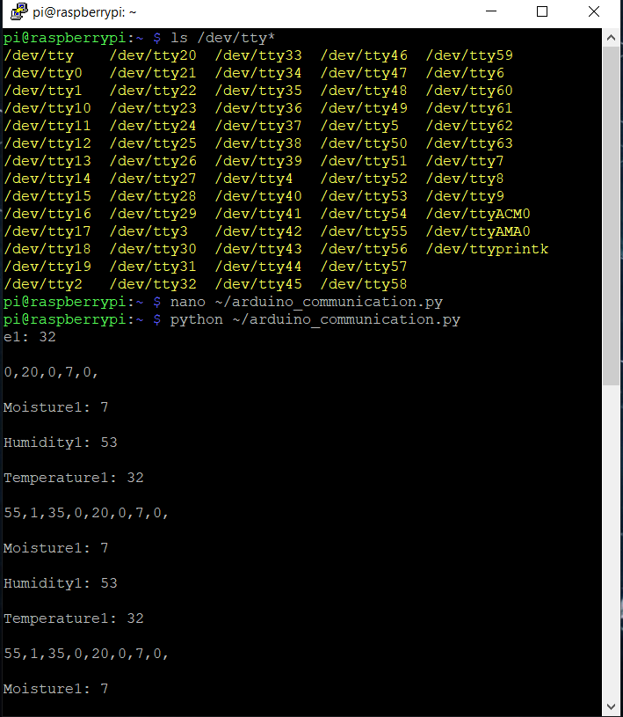
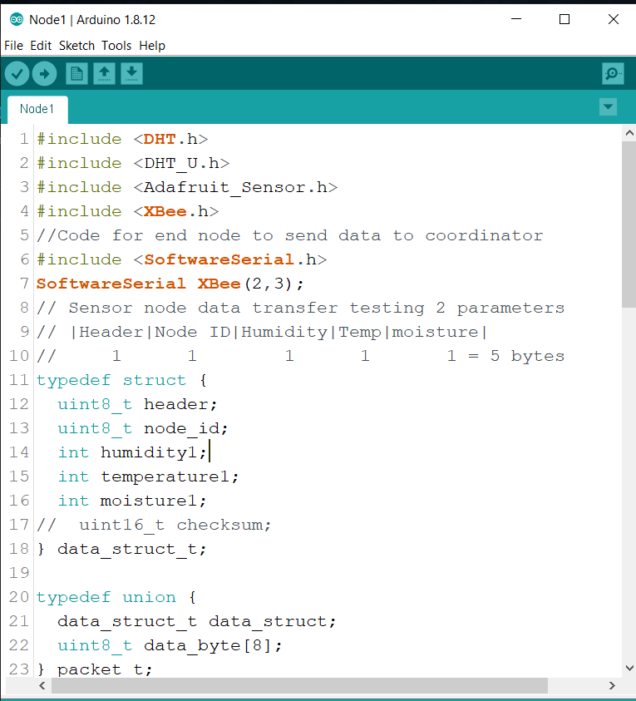
Test Node 1 with Arduino Uno send
Data to Raspberry Pi
Port Arduino Uno
Page 11

Slide 13
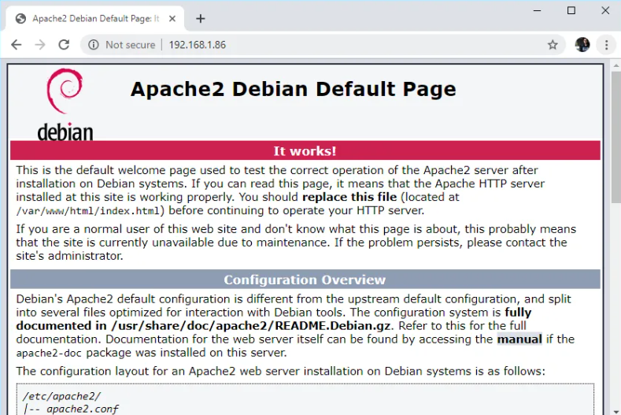
Setup a Raspberry Pi MYSQL Database
Install Apache2 on Raspberry Pi
sudo apt install apache2 –y
cd /var/www/html
ls -al
hostname -I
192.168.0.110
Page 12

Slide 14
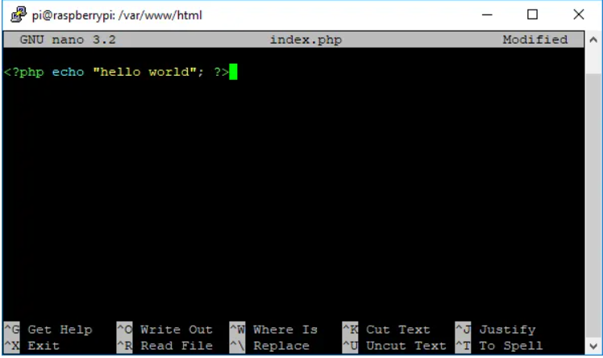
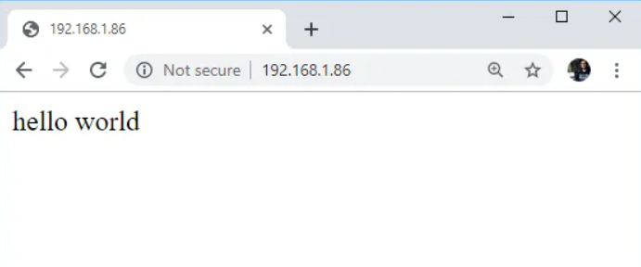

Install PHP on Raspberry Pi
sudo apt install php –y
sudo rm index.html
sudo nano index.php
sudo service apache2 restart
192.168.0.110
Page 13

Slide 15
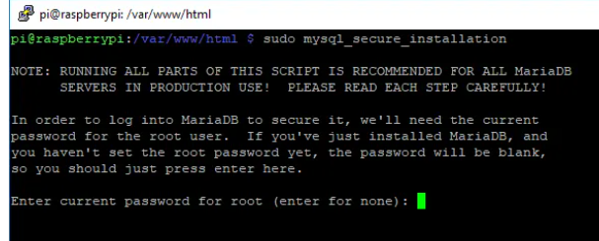
Install MySQL (MariaDB Server) on Raspberry Pi
sudo apt install mariadb-server php-mysql –y
sudo service apache2 restart
sudo mysql_secure_installation
sudo mysql -p -u root
> CREATE USER ‘gtr'@'localhost' IDENTIFIED BY ‘gtr123’;
> GRANT ALL PRIVILEGES ON *.* TO ‘gtr'@'localhost' WITH GRANT OPTION;
> FLUSH PRIVILEGES;
> exit;
Page 14

Slide 16
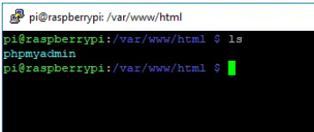
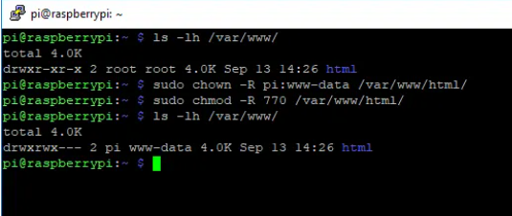
Install phpMyAdmin on Raspberry Pi
sudo apt install phpmyadmin –y
sudo phpenmod mysqli
sudo service apache2 restart
Ls
Optional Step (but recommended)
Page 15

Slide 17
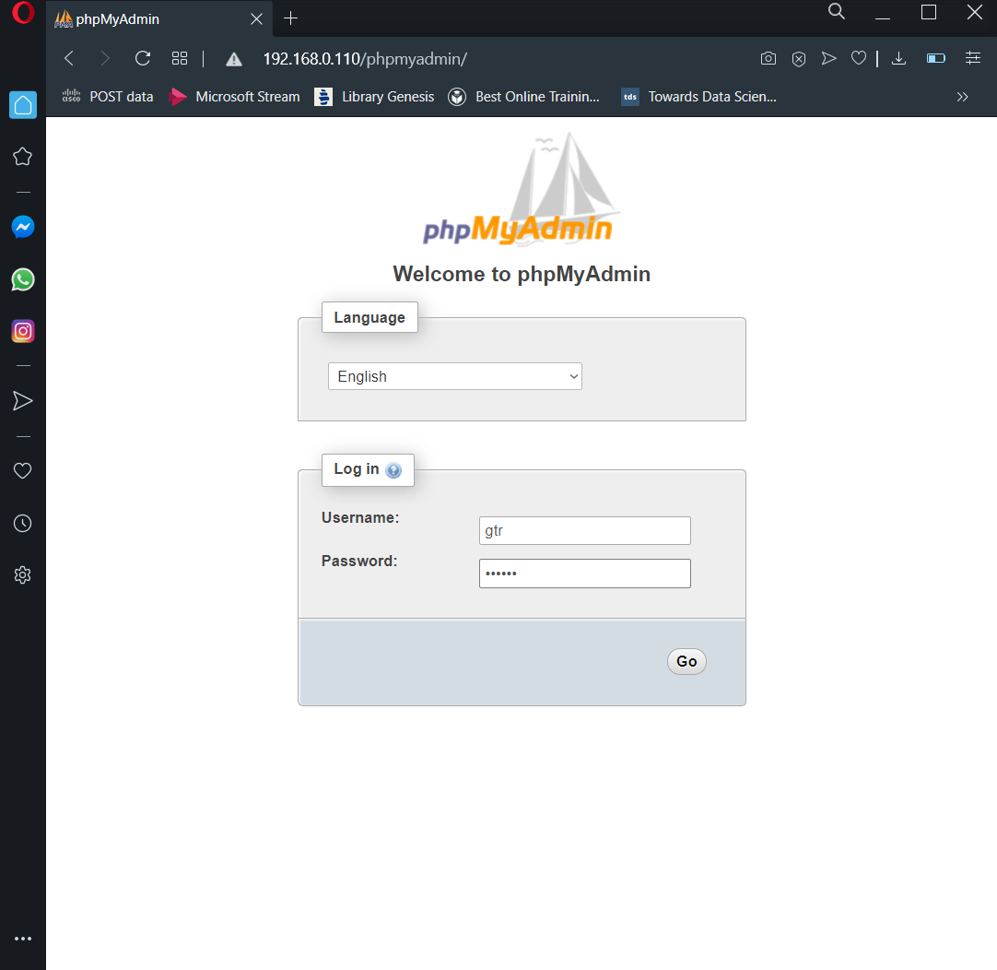
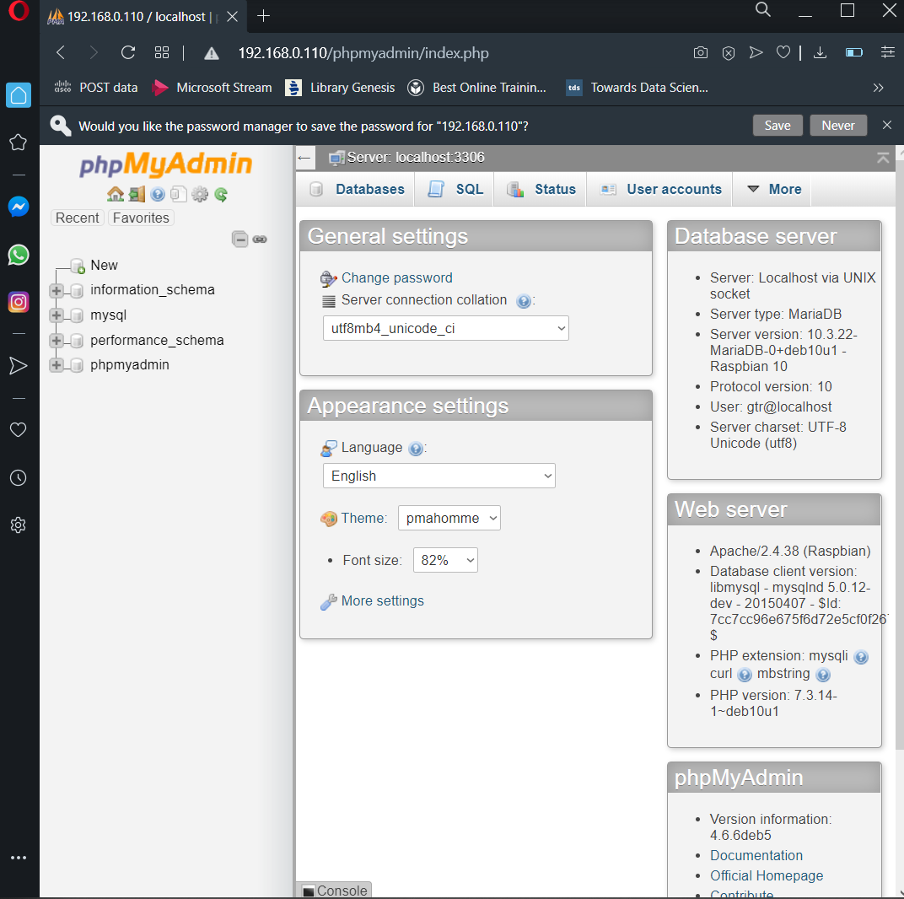
phpMyAdmin
Page 16

Slide 18
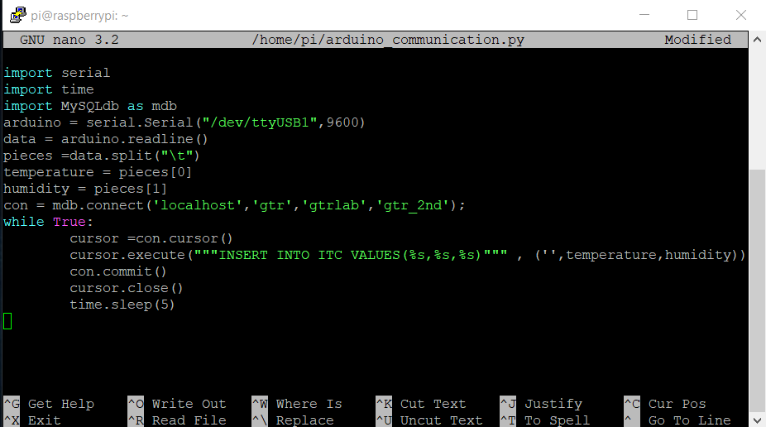
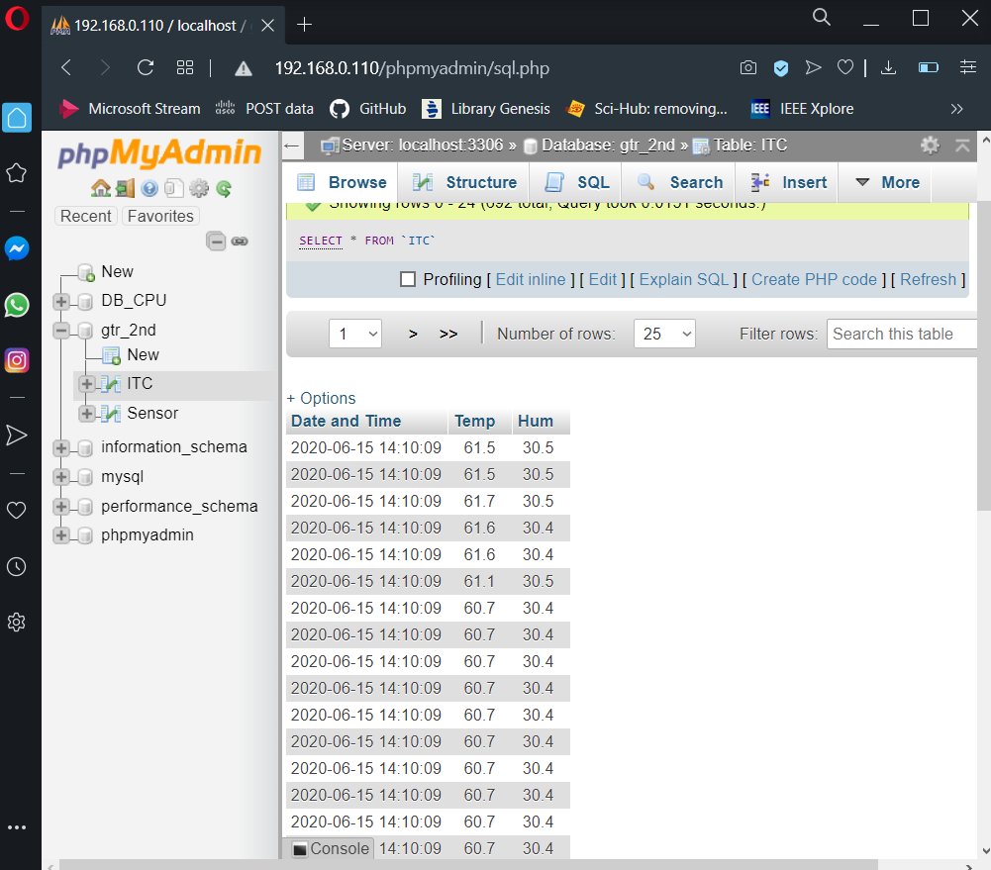
Read Raspberry pi from Arduino on Database
Problem with phpMyAdmin and PHP
https://devanswers.co/problem-php-7-2-phpmyadmin-warning-in-librariessql-count/
Page 17

Slide 19
Thank You!

